Slide 1
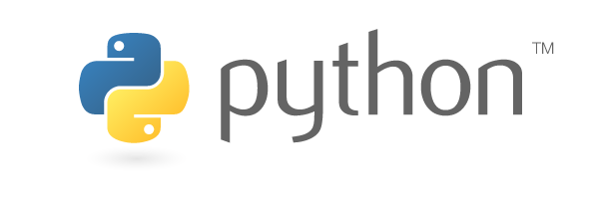

Introduction to Python Programming

Slide 2
Summary on Basic Data Types
int (integer)
Python integer can represent any integer number
as long as it can be stored in computer memory
float
a float number is a sequence of binary digits (bits) 01010101010101…..
float numbers can only represent a subset of real numbers.
If a number is too large in magnitude, it will be represented by +inf or -inf
boolean (True/False) : used in logical operations
string
a string is a sequence of characters: "this is a string", or 'this is a string'
list
a list is a sequence of objects: [1, 2, 3, 10.01, 'a', 'b', 'c']

Slide 3
Boolean Expression
operators
<
>
<=
>=
==
!=
and
or
a < b : a is less than b
a <=b: a is less than or equal to b
a > b : a is greater than b
a >=b: a is greater than or equal to b
Python reads like English a bit:
&& => and
|| => or

Slide 4
String in Python
a string is a sequence of characters in Python
single quotes ' ' or double quotes " "

Slide 5
String in Python
Obtain a character in a string using index (starting from 0)
a string: "abc"

Slide 6
List in Python
a list is a sequence of objects (e.g. integers, or float numbers) in Python
a list of integers

Slide 7
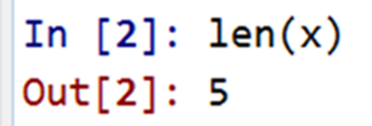
Define a list and Measure the length of a list
define a list using
square brackets
use function len to measure
the length of a list:
the number of elements

Slide 8
List in Python
Obtain an element in a list using index (starting from 0)
a list: [1, 2, 3]

Slide 9
List in Python
a list is a sequence of objects.
elements in a list can be any objects in Python

Slide 10
a Float Number has a finite number of binary digits/bits (64 bits if you are using a 64-bit computer)
a float number is a sequence of binary digits (bits) 01010101010101…..
float('1000') converts a string (real number) to a float number
print(float('1000') ) shows the real number represented by the float
There are ~ 2^64 unique float numbers.
More details can be found in IEEE 754 Floating-Point Standard

Slide 11
Many Integer Types in Python ….
int is a type of integer in Python.
An int number can represent any integer as long as it can be stored in computer memory.
Details in Python doc
int64 is another integer type in Python (Package Numpy)
An int64 number has 64 binary digits (bits).
int64 numbers can only represent a subset of integers
https://docs.python.org/3.6/c-api/long.html
"All integers are implemented as “long” integer objects of arbitrary size."

Slide 12
Spyder IDE (Scientific Python Development Environment) with Python 3.6
Editor Window
Write multiple lines of code
Console Window
Interact with Python Interpreter

Slide 13
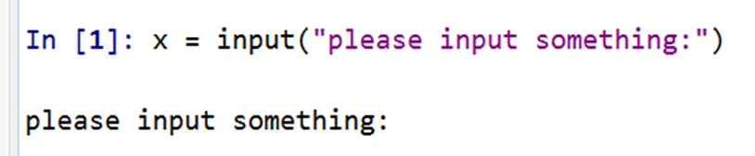
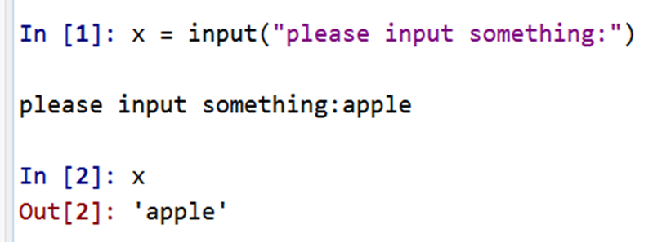

the input function: asking the user for input from the console
use the function input() to get a string from the user via the keyboard.
Python provides a built-in function called input that gets input from the keyboard.
Python now waits for the user to input something
When this function is used/called, the program stops and waits for the user (e.g. your teacher) to type something.
The user inputs apple and presses Enter on the keyboard
Any user input will be converted to a string.
Now, x 'becomes' a string 'apple'
x is always a string from input
the value returned from the function input is a string.
if the user inputs a number 123, x is a string "123"

Slide 14
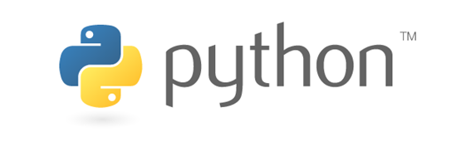
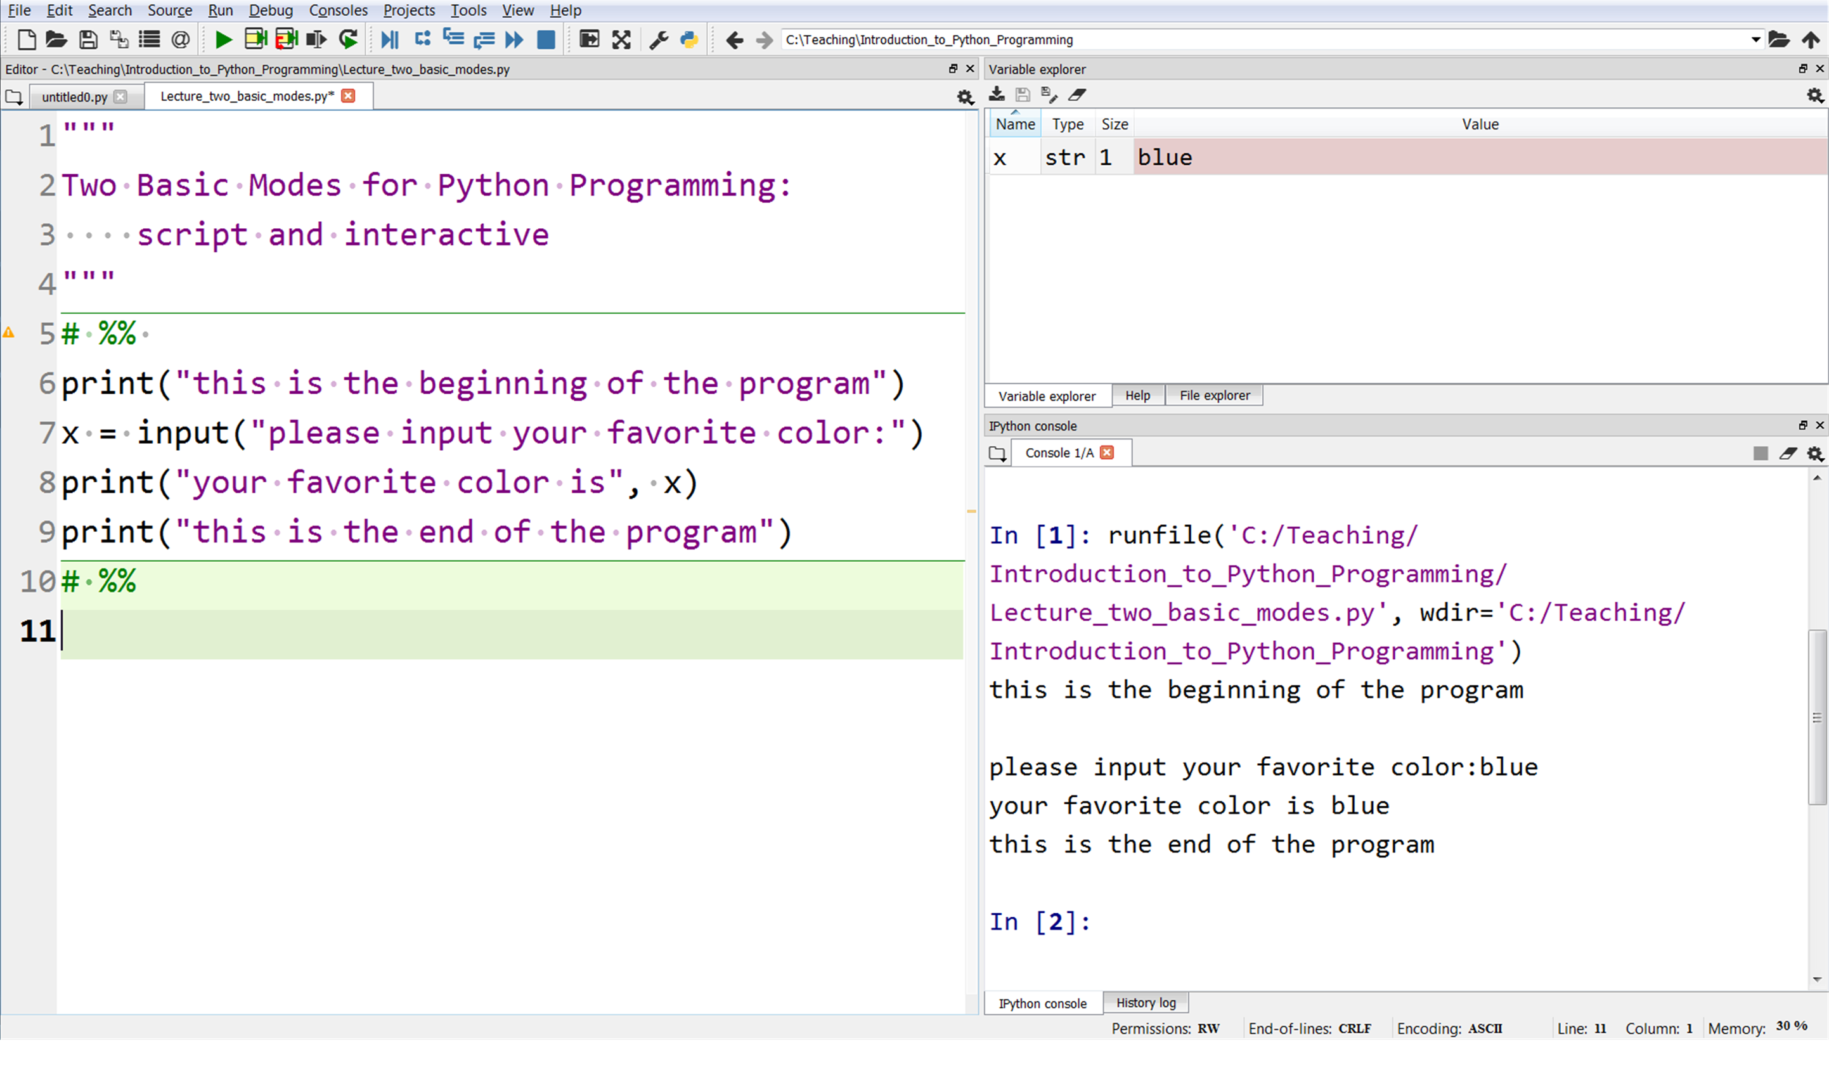
Two Programming Modes: script and interactive
script mode (in Spyder): Python runs the whole program from top to bottom in the .py file

Slide 15
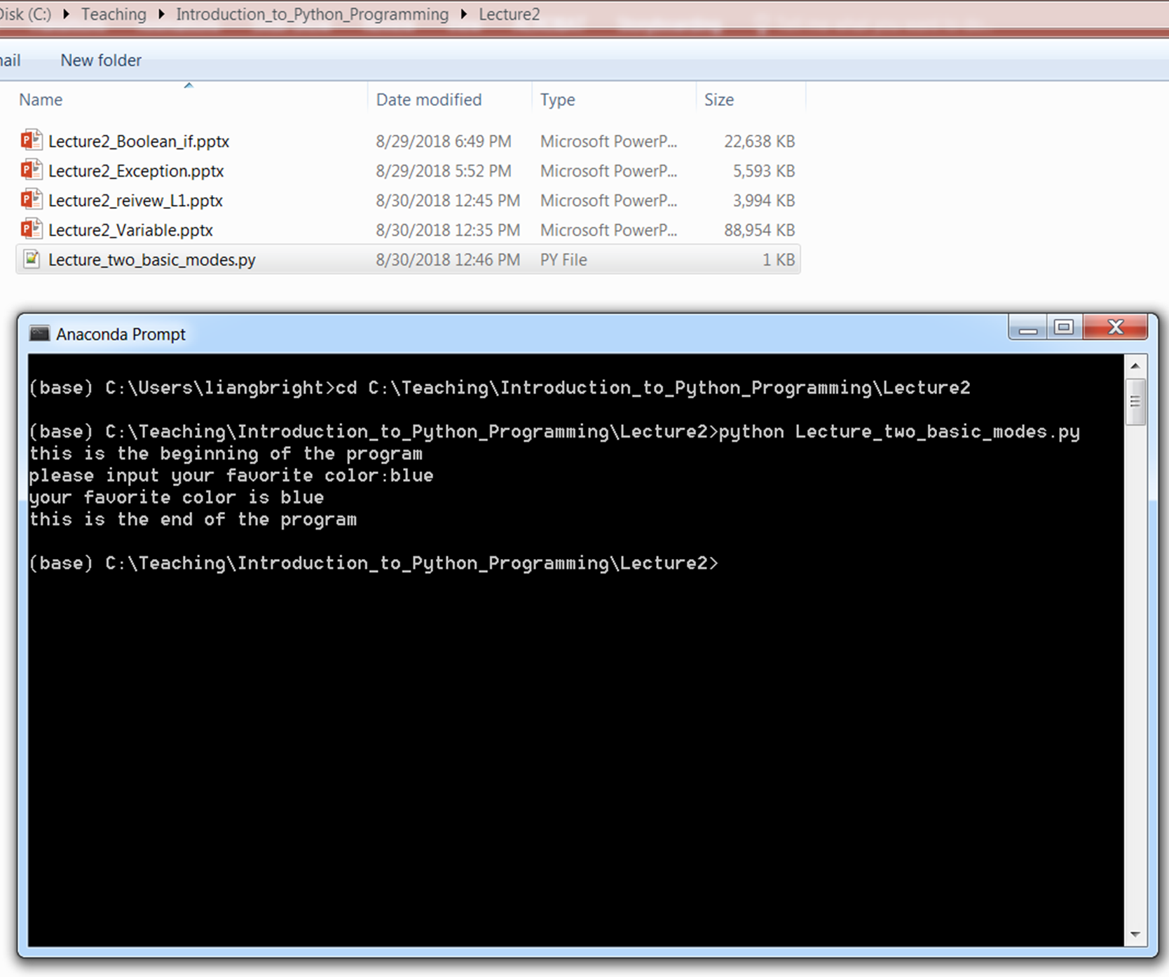
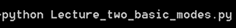
Two Programming Modes: script and interactive
script mode (in command window/terminal): we run the Python program in the .py file
Python program is in the file
Lecture_two_basic_modes.py

Slide 16
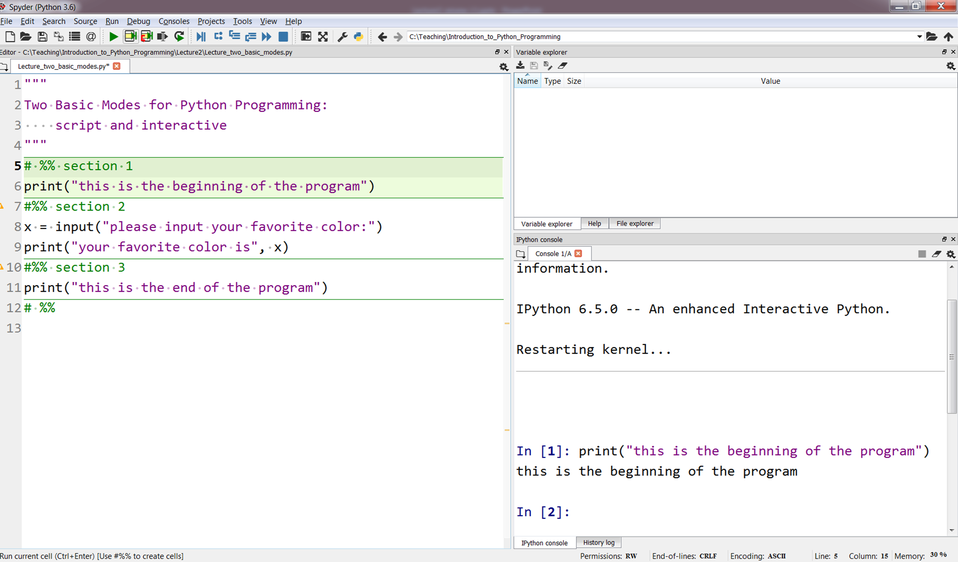
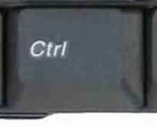
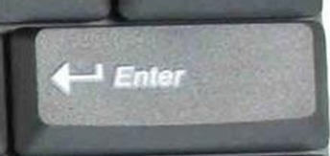
Two Programming Modes: script and interactive
interactive mode: we run a small section of Python code at a time
move mouse cursor in this section

Slide 17
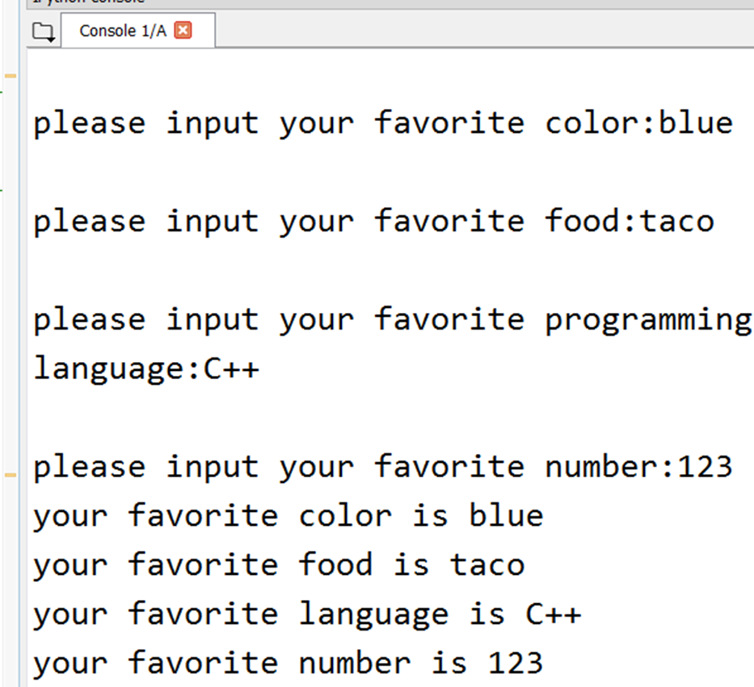

Programming Exercise (5-10 min)
Write a Python program in Spyder to ask the user to input some information:
favorite color, favorite food, favorite programming language, favorite number
any other information you want to ask
Print the information of the user (using print function)
You need some variables to "store" the input information
Run the program in interactive mode and script mode
The output should look like this …
the programmer
Python Code

